Slide 2
Microinteractions with Lottie JS
Jose Atencio

Slide 3
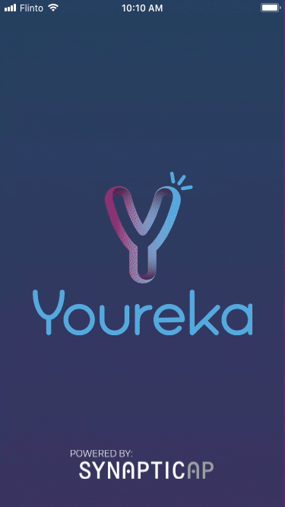
What is a Microinteraction?
Microinteractions are contained product moments that revolve around a single use case—they have one main task. Every time you change a setting, sync your data or devices, set an alarm, pick a password, log in, set a status message, or favorite or “like” something, you are engaging with a microinteraction.

Slide 4
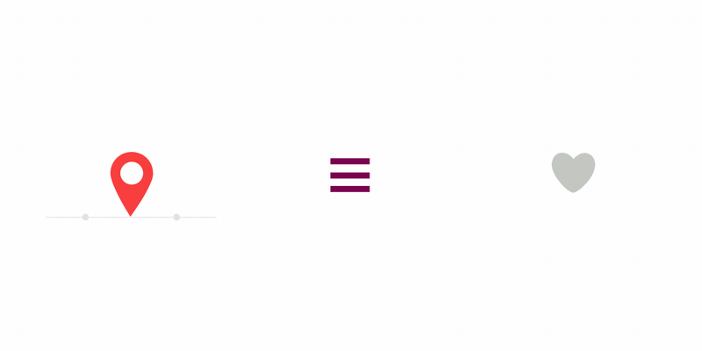
What is Lottie JS?
Lottie is a mobile library for Android and iOS that parses Adobe After Effects animations exported as JSON with Bodymovin and renders them natively on mobile and on the web!

Slide 5
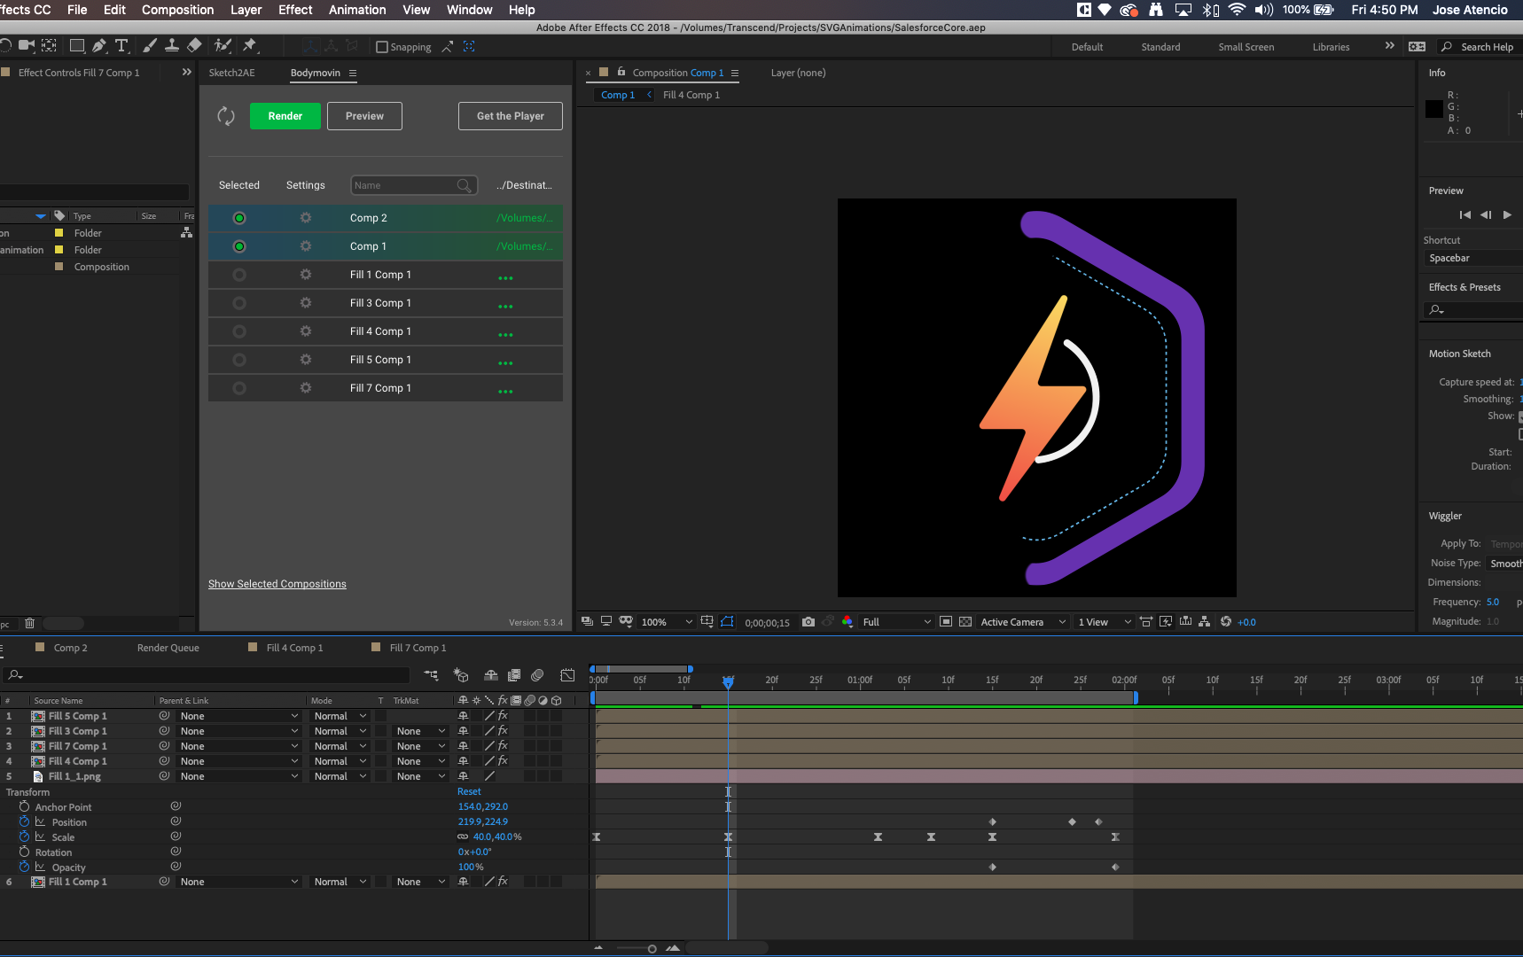
About Bodymovin
Is an After Effects extension to export animations for web. Animations are exported as .json files that use the bodymovin.js player that comes along with the plugin. You can render animations in the browser on SVG, canvas and html.

Slide 6
Plugin Installation
Is an After Effects extension to export animations for web. Animations are exported as .json files that use the bodymovin.js player that comes along with the plugin. You can render animations in the browser on SVG, canvas and html.

Slide 7
More Info:
https://medium.muz.li/how-you-can-improve-ux-with-microinteractions-part-i-73c8dfc01ca3
https://airbnb.io/lottie/
https://github.com/mrtolix/lottie-microinteraction
https://www.flaticon.com/packs/emotions-3
https://www.uplabs.com/
https://www.pluralsight.com/courses/beginning-after-effects-cc

Slide 8
Jose Atencio
Graphic Designer
Jose.Atencio@synapticap.com

